Slide 1
Interference between I/O and MPI Traffic on Fat-tree Networks
Brown, Kevin A., et al.
Proceedings of the 47th International Conference on Parallel Processing. 2018.
Cloud Computing
221025 Sohee Kim
Notes:
Brown, Kevin A., et al. "Interference between I/O and MPI traffic on fat-tree networks." Proceedings of the 47th International Conference on Parallel Processing. 2018.
https://dl.acm.org/doi/pdf/10.1145/3225058.3225144

Slide 2
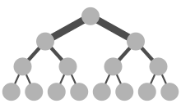
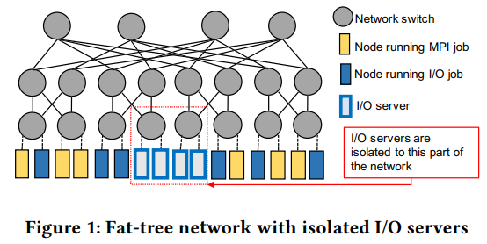
1. Introduction
Brown, Kevin A., et al. "Interference between I/O and MPI traffic on fat-tree networks." Proceedings of the 47th International Conference on Parallel Processing. 2018.
https://en.wikipedia.org/wiki/Fat_tree
High performance computing (HPC) workloads
Data movement – significant performance degradation for many applications
Off-node data movement : MPI or I/O
This paper characterizes the effects of interference between MPI and I/O traffic on the performance of each of these traffic types
Several factors : message sizes, communication intervals, system allocations, and task placement
Evaluate the efficacy of several optimization strategies in mitigating the performance impact of MPI-I/O interference
Fat-tree topology, CODES simulation framework
Notes:
Many production high performance computing (HPC) workloads involve significant data exchange among compute nodes as well as between compute nodes and parallel file systems.
Data movement is necessitated because simulation data can rarely fit on a single compute node, and due to file input/output requirements of computational simulations.
Past research has shown that such data movement on HPC systems is a source of significant performance degradation for many applications.
Studies have also shown that off-node data movement is particularly susceptible to interference on systems where the network infrastructure is shared by all running jobs [5, 25]. However, with the exception of Mubarak et al. [17], these studies have focused on network traffic generated by one of the two major sources of off-node data movement: MPI or I/O
In order to develop a better understanding of the aforementioned topics, this paper characterizes the effects of interference between MPI and I/O traffic on the performance of each of these traffic types. Our characterization explores several factors that may impact the interference, including message sizes, communication intervals, system allocations, and task placement
They focus on the fat-tree topology, and
In order to avoid being limited by the constraints posed by deployed systems, e.g. the placement of I/O servers, we use the CODES simulation framework to conduct our study [18].

Slide 3
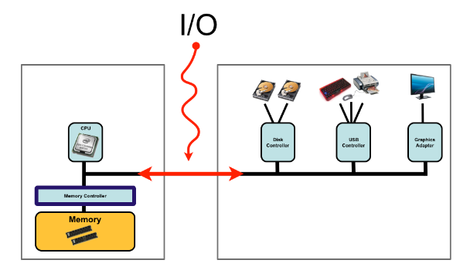
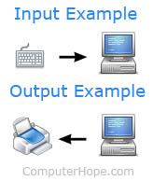
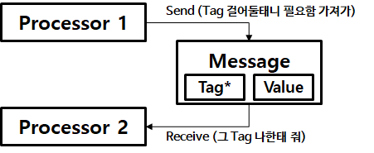
2. Background and related work
Brown, Kevin A., et al. "Interference between I/O and MPI traffic on fat-tree networks." Proceedings of the 47th International Conference on Parallel Processing. 2018.
I/O Traffic (Input/Output)
Split I/O request into fixed-sized chunks – better pipeline and parallelize requests
How I/O requests can cause congestion on the storage severs as well as on the network -> degrade performance
None of studies have evaluated the effect of I/O congestion, mitigation techniques on non-I/O jobs that share network
MPI Traffic (Message Passing Interface)
Most HPC applications use the MPI for communication and their performance can be sensitive to communication latency
Congestion due to MPI traffic within the same application -> degrade performance
HPC applications generate a wide range of message sizes at a wide range of communication frequencies. -> impact congestion caused by MPI traffic
> Message Passing
https://jongmin92.github.io/2019/02/18/Programming/computer-structure/
https://next-brain.tistory.com/32
Notes:
(Lustre) Lustre splits I/O requests into fixed-sized chunks in order to better pipeline and parallelize requests
Notable I/O optimization studies have shown how I/O requests can cause congestion on the storage servers as well as on the network, specifically on links that are directly connected to I/O servers.
This congestion degrades the performance of I/O jobs, and various techniques such as I/O prefetching, buffering, scheduling, and throttling have been proposed to mitigate this degradation. However, none of these studies have evaluated the effect of I/O congestion, and that of mitigation techniques on non-I/O jobs that share the network.
Most HPC applications use the Message Passing Interface (MPI) for communication and their performance can be sensitive to communication latency. Optimized MPI libraries attempt to ensure that sensitive communication tasks on the application’s critical path are not delayed unnecessarily.
However, it is common to observe congestion due to MPI traffic within the same application which can degrade performance [4, 24].
Several surveys of representative MPI workloads have indicated that HPC applications generate a wide range of message sizes from small (few KBs) to large (few MBs) at a wide range of communication frequencies [7, 13]. These characteristics of application communication patterns impact the congestion caused by MPI traffic, and therefore, should be considered when characterizing MPI performance.

Slide 4
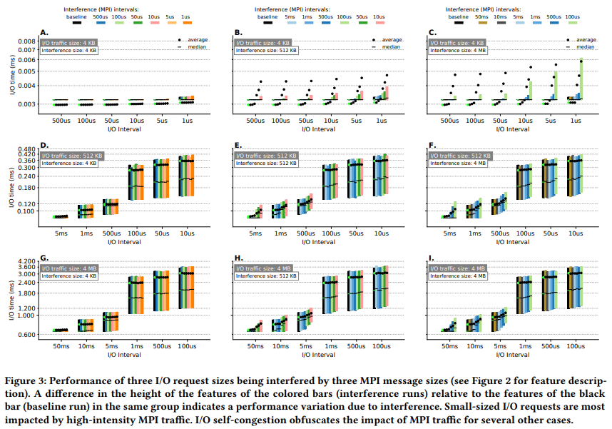
3. Characterization of interference
Brown, Kevin A., et al. "Interference between I/O and MPI traffic on fat-tree networks." Proceedings of the 47th International Conference on Parallel Processing. 2018.
I/O job
The latency of small I/O requests is sensitive to high-intensity MPI interference
Not affected
Increase
(1.9X slowdown)
4 KB
The increase is not due to the presence of MPI traffic
512 KB
No interference
I/O-congestion threshold
4 MB
an increase in the MPI traffic intensity causes a corresponding increase in the I/O request times
4 KB
512 KB
4 MB
Notes:
This Figure shows the I/O performance when different I/O request sizes interact with different MPI message sizes.
Black bars are baseline, that show the I/O request time when there is no MPI interference.
Chart A shows no significant changes in the position of the dots and bars within any cluster, indicating that the performance of 4 KB I/O requests is not affected by 4 KB MPI background interference.
However, when the size of the interfering messages increases to 4 MB, as shown in Chart C, the latency of 4 KB requests increases significantly.
This demonstrates that the latency of small I/O requests is sensitive to high-intensity MPI interference.
In Charts D-I, there is a significant increase in the I/O times for the rightmost three clusters. As this increase also occurs for the black baseline bars, which show the runtimes when there is no interference, the increase is not due to the presence of MPI traffic.
We will refer to the I/O interval around which this rapid increase in request time happens as the I/O-congestion threshold.
I/O-congestion threshold is between 500- 100 µs for 512 KB requests and between 5-1 ms for 4 MB requests.
When the interfering MPI message size is 512 KB (Charts B, E, H) and 4 MB (Charts C, F, I), an increase in the MPI traffic intensity causes a corresponding increase in the I/O request times before the I/O-congestion threshold is reached.
- Graph I
an increase in the MPI traffic intensity causes a corresponding increase in the I/O request times before the I/O-congestion threshold is reached.
Once we cross the I/O-congestion threshold at 1 ms I/O intervals, the interfering MPI traffic does not show a significant impact on I/O performance.

Slide 5
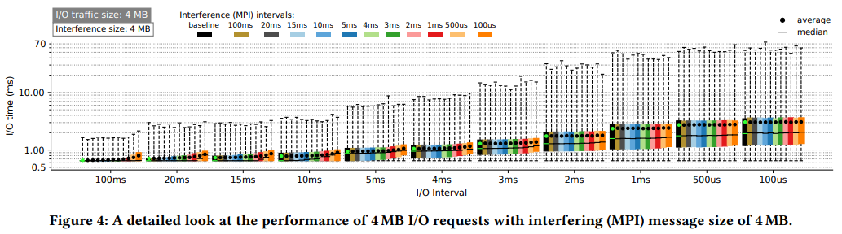
3. Characterization of interference
Brown, Kevin A., et al. "Interference between I/O and MPI traffic on fat-tree networks." Proceedings of the 47th International Conference on Parallel Processing. 2018.
I/O job
4 MB
I/O-congestion threshold
The impact of interference caused by MPI gradually declines as the I/O interval approaches the I/O congestion threshold.
If the time per I/O request is more important than the volume of requests for an I/O job, it is better to send less frequent requests despite the higher relative impact of interference from MPI.
Notes:
Figure 4 presents a more detailed view of the case in which 4 MB I/O requests interact with 4 MB MPI messages.
The inclusion of additional intervals shows that the impact of interference caused by MPI gradually declines as the I/O interval approaches the I/Ocongestion threshold.
At the 2 ms I/O interval, there is minimal increase in the average and 75th percentile time within the cluster. Nevertheless, after the I/O-congestion threshold is reached, even the baseline is higher than the interference runs prior to the threshold. The detailed trends seen here can be used to represent the behavior of different I/O request sizes as Figure 3 suggests that different I/O request sizes exhibit a similar pattern around their I/O-congestion threshold.
Overall, we conclude that if the time per I/O request is more important than the volume of requests for an I/O job, it is better to send less frequent requests despite the higher relative impact of interference from MPI.

Slide 6
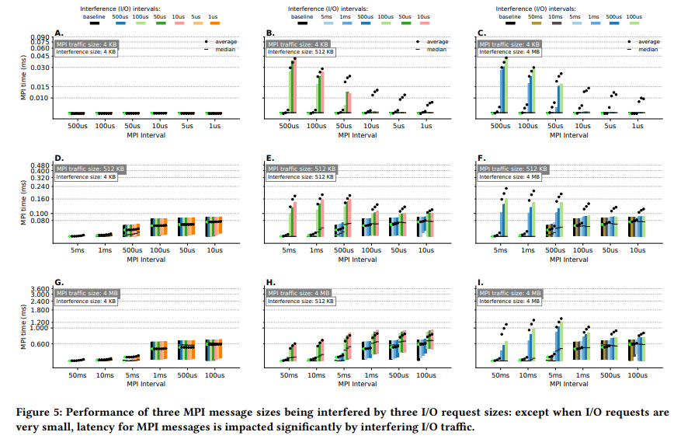
3. Characterization of interference
Brown, Kevin A., et al. "Interference between I/O and MPI traffic on fat-tree networks." Proceedings of the 47th International Conference on Parallel Processing. 2018.
MPI job
4 KB
512 KB
4 MB
4 KB
512 KB
4 MB

Slide 7
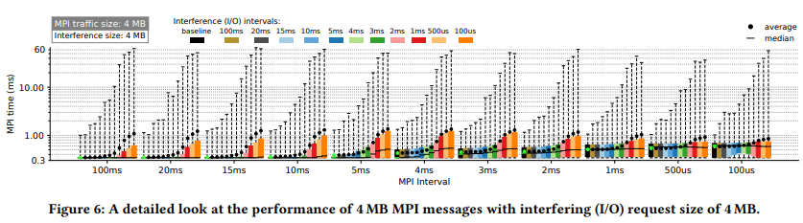
3. Characterization of interference
Brown, Kevin A., et al. "Interference between I/O and MPI traffic on fat-tree networks." Proceedings of the 47th International Conference on Parallel Processing. 2018.
MPI job
1.34ms
0.85ms

Slide 8
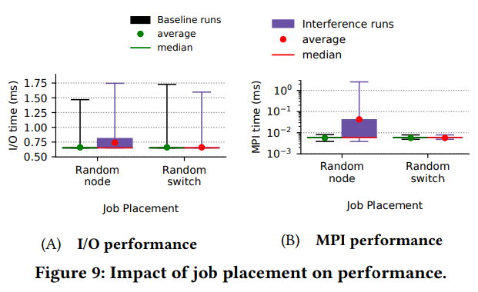
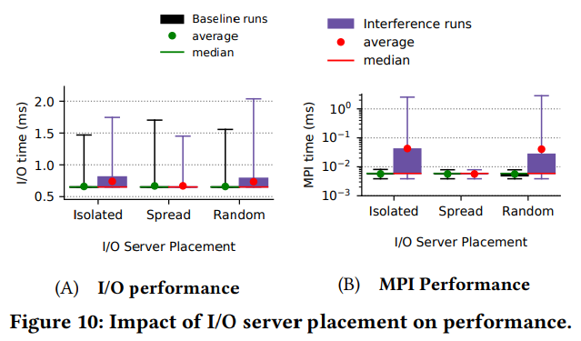
4. Mitigation strategies
Brown, Kevin A., et al. "Interference between I/O and MPI traffic on fat-tree networks." Proceedings of the 47th International Conference on Parallel Processing. 2018.
Job Placement
I/O server Placement
Increase(11.8%)
Increase
(800%)
similar
similar
Random switch
Improvements - All links connected to switches with I/O servers and clients carry only I/O traffic
The I/O traffic is confined to a subset of the network and thus does not interfere with the MPI traffic

Slide 9
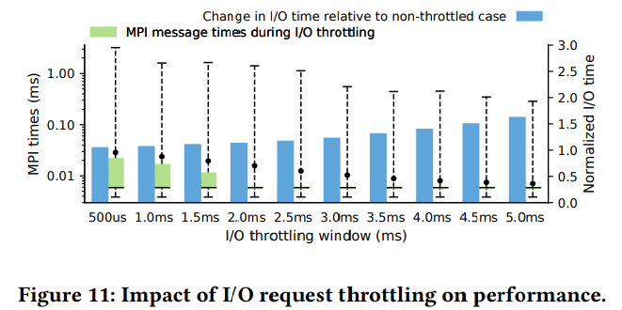
4. Mitigation strategies
Brown, Kevin A., et al. "Interference between I/O and MPI traffic on fat-tree networks." Proceedings of the 47th International Conference on Parallel Processing. 2018.
Throttling I/O Traffic
the process of regulating the rate at which I/O requests are sent or processed
Random-node job placement, isolated-target I/O server
Duration between the start times of 2 consecutive requests

Slide 10
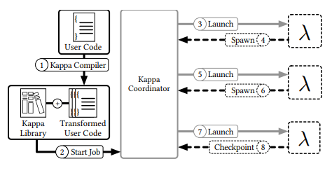
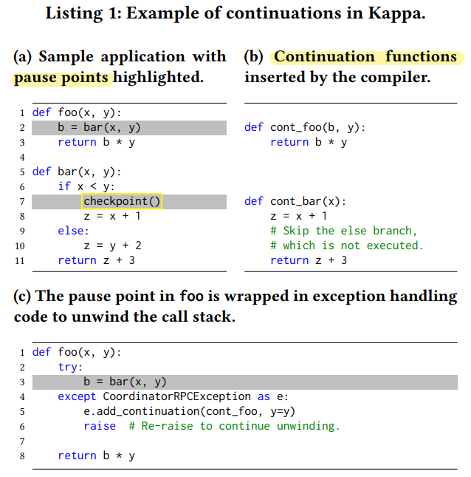
2. Kappa Design
Zhang, Wen, et al. "Kappa: A programming framework for serverless computing." Proceedings of the 11th ACM Symposium on Cloud Computing. 2020.
Checkpointing
Example of continuations
Checkpoints – implemented using continuations
A well understood technique for suspending and resuming execution
A closure that captures program state and control flow information at some execution point
Pause points
Takes a checkpoint by generating a continuation and serializing it to storage
Restores from a checkpoint by deserializing and invoking a previously stored continuation
Checkpoint (list)
Function name
Live variables
Hole
- Previous continuation’s result
Notes:
As mentioned before, Kappa uses checkpoints to tolerate lambda function timeouts and to prevent RPC duplication.
Checkpoints in Kappa are implemented using continuations [74], a language-level mechanism executed in user mode. Continuations are a well understood technique for suspending and resuming execution, and have been used in past systems for checkpointing and fault tolerance [79, 88], task migration [28, 78, 79, 88], asynchronous calls [51, 54], context switching [86], and debugging [16]. Kappa’s checkpointing technique is nearly identical to that of previous systems, although there might be implementation differences.
A continuation can be thought of as a closure that captures program state and control flow information at some execution point; calling the closure resumes execution from this point in the program.
Kappa takes a checkpoint by generating a continuation and serializing it to storage, and restores from a checkpoint by deserializing and invoking a previously stored continuation.
This list is an example of continuations. I will explain how continuations are generated for the checkpoint() call on line 7. The code is first transformed by the Kappa compiler, which identifies all the pause points in the code, which is highlighted. There are 2 pause points.
For each, the compiler generates a continuation function definition and inserts it into the source code.
As shown in B, a continuation function contains all the code that executes after the corresponding pause point, and takes a arguments any variable whose value is accessed by the subsequent code (called live variables)
Finally, consider the function call foo(3,4) at execution time. The checkpoint taken by bar can be written as a list consisting of one continuation per frame on the call stack: [(cont_bar, x = 3), (cont_foo, b = □, y = 4)] ,
where a continuation is a tuple of (1) its continuation function’s name and (2) live variables in that frame; “□” denotes a hole to be filled in with the previous continuation’s result.
To resume from this checkpoint, the Kappa library invokes the continuations in order (e.g., cont_bar(x=3)), substituting each continuation’s return value into its successor’s hole. The return value of the topmost function—i.e., the task’s final result—is reported to the coordinator.

Slide 11
5. Limitations, Conclusion
Zhang, Wen, et al. "Kappa: A programming framework for serverless computing." Proceedings of the 11th ACM Symposium on Cloud Computing. 2020.
Limitations
Unsupported Python features
not yet added support for some Python features (try/except, yield, async/await, nested function definitions, global variables) to the compiler’s continuation generation logic
Other restrictions on input code
The programmer must: Insert checkpoint(), Mark calls that have externally visible side-effects with @on_coordinator, Use Kappa’s concurrency primitive instead of primitives such as Python threads
Static pause points
Restricts where checkpoints can be generated and precludes deciding checkpoint locations at runtime
Can only checkpoint in transformed code
Checkpoint only in code transformed by the its compiler and not in a Python C extension like numpy
Kappa is a framework that simplifies serverless development by providing a familiar programming model.
By reducing the friction of developing serverless programs, Kappa provides an avenue for a larger set of applications to take advantage of the benefits of serverless computing.
Notes:
While Kappa already supports a wide range of applications, it has a few limitations :
First, They have not yet added support for some Python features to the compiler’s continuation generation logic
Beyond the aforementioned restrictions on Python features, Kappa requires minor modifications to application code.
The programmer must: Insert checkpoint() calls at appropriate points in the program, Mark calls that have externally visible side-effects (e.g., resulting in I/O) with @on_coordinator, and Use Kappa’s concurrency primitives (§ 3.3) instead of primitives such as Python threads.
Kappa identifies pause points statically, and this approach reduces the runtime overhead of checkpointing, but restricts where checkpoints can be generated and precludes deciding checkpoint locations at runtime. Relaxing this limitation through dynamic continuation computation is left to future work.
Kappa can checkpoint only in code transformed by the its compiler and not in, e.g., a Python C extension like numpy.
Python’s dynamic nature makes it challenging to statically analyze application code
Although serverless computing originally targeted event handling, recent efforts such as ExCamera [27] and PyWren [40] have enabled the use of serverless for more diverse applications. However, developing serverless applications still requires significant effort. Kappa is a framework that simplifies serverless development by providing a familiar programming model. By reducing the friction of developing serverless programs, Kappa provides an avenue for a larger set of applications to take advantage of the benefits of serverless computing.

Slide 12
Thank You ☺

